Slide 1
CS 4530: Fundamentals of Software Engineering Module 9-10 Distributed Systems
Jonathan Bell, Adeel Bhutta, Mitch Wand
Khoury College of Computer Sciences
© 2022 Released under the CC BY-SA license

Slide 2
CS 4530: Fundamentals of Software Engineering Lesson 9.1 Distributed Systems: Goals and Challenges
Jonathan Bell, Adeel Bhutta, Mitch Wand
Khoury College of Computer Sciences
© 2022 Released under the CC BY-SA license

Slide 3





What is a distributed system?
Model One:
Many servers talking through a network
Model Two:
Many servers and clients talking through a network
Notes:
First: some ground rules. What is a distributed system? Most apps that we work with are distributed in some way, at least in the sense that there is some code that runs in a client, and elsewhere on a server. For this and the following lesson, however, we’ll focus primarily on what happens when the server code needs to be distributed across multiple computers, with a network connecting them.

Slide 4
Distributed Systems Goals
Scalability
Performance
Latency
Availability
Fault Tolerance
“Distributed Systems for Fun and Profit”, Takada
Notes:
Why go through the effort of implementing, deploying and maintaining a distributed system? Here are the general goals a DS should address. We’ll look at a motivating example next, and then jump back to these goals to discuss them in greater details.
For now, it should suffice to recognize the most common reason for why a system needs to become distributed - Scale: be able to turn a knob and have “more” of the system - respond to more requests than otherwise possible

Slide 5
Distributed Systems Goals
Scalability
Performance
Latency
Availability
Fault Tolerance
“the ability of a system, network, or process, to handle a growing amount of work in a capable manner or its ability to be enlarged to accommodate that growth.”
“Distributed Systems for Fun and Profit”, Takada
Notes:
Let’s revisit the distributed systems goals, and see how we can design systems to address them, starting with scale.
Most things are easy to do small: Let’s make a system that lets 5 people run around a 2D map. Great! How do we let 100,000 people run around that same map? Uh-oh. A scalable system is one in which we can scale the resources available to the system up in a way that is hopefully sub-linear to the scale in demand for usage. If our software can’t be distributed over multiple computers, then we are limited in scale to the resources that a single large computer can provide. This is the case for DNS.

Slide 6
Distributed Systems Allow Horizontal Scaling
“Vertical” scaling: add more resources to existing server
Faster CPUs, more CPU cores, more RAM, more storage
Becomes ineffective : Clock speed plateaus; difficult to write applications that utilize 256 CPU cores (adding 2TB RAM to a server can often help)
“Horizontal” scaling: add more servers
Rely on “commodity” servers rather than state-of-the-art hardware
Allows for dynamic addition of resources as needed by load
Notes:
(Read slide)

Slide 7
Distributed Systems Goals
Scalability
Performance
Latency
Availability
Fault Tolerance
“is characterized by the amount of useful work accomplished by a computer system compared to the time and resources used.”
“Distributed Systems for Fun and Profit”, Takada
Notes:
Performance is measured perhaps by throughput (how much work gets done), but also utilization of resources (are we using an enormous amount of resources to achieve this throughput?)
(response time is latency, will get to that in a minute)

Slide 8
Multiple Servers Can Improve Throughput With Concurrency
Throughput: total requests that can be processed per unit-time
Facebook.com
Request
Cache Check
Build friends list
Build Newsfeed
Build Suggestions
Send response
Response
Request
Facebook.com
Response
Cache Check
Build friends list
Build Newsfeed
Build Suggestions
Send response
Build friends list
Build Newsfeed
Build Suggestions
Notes:
Distributed systems can improve throughput through concurrency. If we can create a system that uses more machines to do more work concurrently, then we can satisfy more requests in the same amount of time.
The figure shows a way to (theoretically) double the throughput of a site like Facebook. Serving a request might require a few different key steps to occur. If we could perform those steps for different requests concurrently, we can increase our throughput.
Note that it is also worthwhile to note that we could implement the concurrency on a single node. But, eventually we will reach the limitations of how many things can be done at once on a single server - and then we will need to consider distributing the work to multiple nodes.

Slide 9
Distributed Systems Goals
Scalability
Performance
Latency
Availability
Fault Tolerance
“The state of being latent; delay, a period between the initiation of something and the it becoming visible.”
In a multi-server system, we can select a server that is closer to the user.
“Distributed Systems for Fun and Profit”, Takada
Notes:
Latency captures response time. How long does it take between a user making a request and receiving their response?

Slide 10
Distributed Systems Goals
Mitch says: what is the difference between fault-tolerance and availability?
Scalability
Performance
Latency
Availability
Fault Tolerance
“the proportion of time a system is in a functioning condition. If a user cannot access the system, it is said to be unavailable.”
Availability = uptime / (uptime + downtime).
Often measured in “nines”
Availability % | Downtime/year
90% | >1 month
99% | < 4 days
99.9% | < 9 hours
99.99% | <1 hour
99.999% | 5 minutes
99.9999% | 31 seconds
“Distributed Systems for Fun and Profit”, Takada
Notes:
The next goal that we often try to achieve with distributed systems is availability - the proportion of time that a system is functioning.
It is hard to handle availability on a single machine. because we want redundancy. CLICK to show table we want to take a bunch of unreliable components and build a bigger thing that itself is reliable. what are the components and what kinds of redundancy can we provide?
Availability considers things more broadly than uptime though: what if there is a network outage? Without knowing every possible thing that can fail, instead, we might design for fault tolerance

Slide 11
Distributed Systems Goals
Mitch says: what is the difference between fault-tolerance and availability?
Scalability
Performance
Latency
Availability
Fault Tolerance
“ability of a system to behave in a well-defined manner once faults occur”
What kind of faults?
Disks fail
Networking fails
Power supplies fail
Security breached
Datacenter goes offline
Power goes out
“Distributed Systems for Fun and Profit”, Takada
Notes:
Closely connected to availability is fault tolerance. If something bad happens, regardless of whether the system is temporarily unavailable, our system should eventually recover.
Anticipating all faults and failure modes is a challenge - several are listed here.

Slide 12
Distributed Systems Challenges
Number of nodes + distance between them
Notes:
What makes it difficult for us to achieve these goals?
An increase in the number of independent nodes may increase the need for communication between nodes (click) (reducing performance as scale increases)
And links can fail, too! (click). More links, higher probability of failure.

Slide 13
More machines, more problems
Say there’s a 1% chance of having some hardware failure occur to a machine in a given month (power supply burns out, hard disk crashes, etc)
Now I have 10 machines
Probability(at least one fails during the month) = 1 - Probability(no machine fails) = 1-(1-.01)¹⁰ = 10%
100 machines -> 63% chance that at least one fails
200 machines -> 87% chance that at least one fails (!)
Implication: System as a whole must tolerate component failures
Notes:
(Read slide)

Slide 14
Networks introduce delays
Cannot expect network to be a perfect analog for communication within a single computer because:
Speed of light (1 foot/nanosecond)
Communication links exist in uncontrolled/hostile environments
Communication links may be bandwidth limited (tough to reach even 100MB/sec)
In contrast to a single computer, where:
Distances are measured in mm, not feet
Physical concerns can be addressed all at once
Bandwidth is plentiful (easily GB/sec)
Notes:
(Read slide)

Slide 15


Networks still fail, intermittently and for prolonged periods

Slide 16
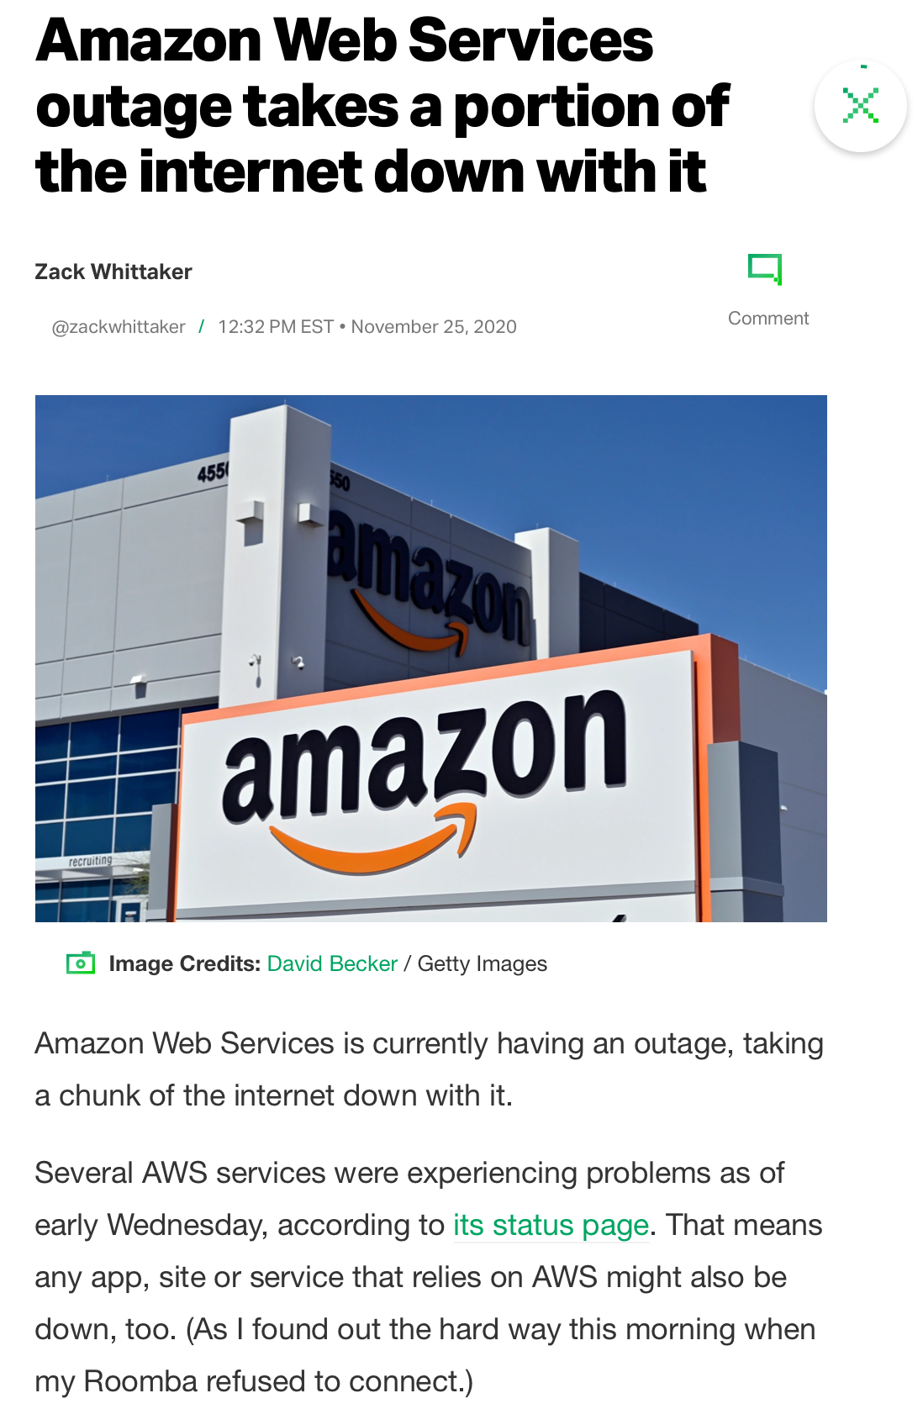
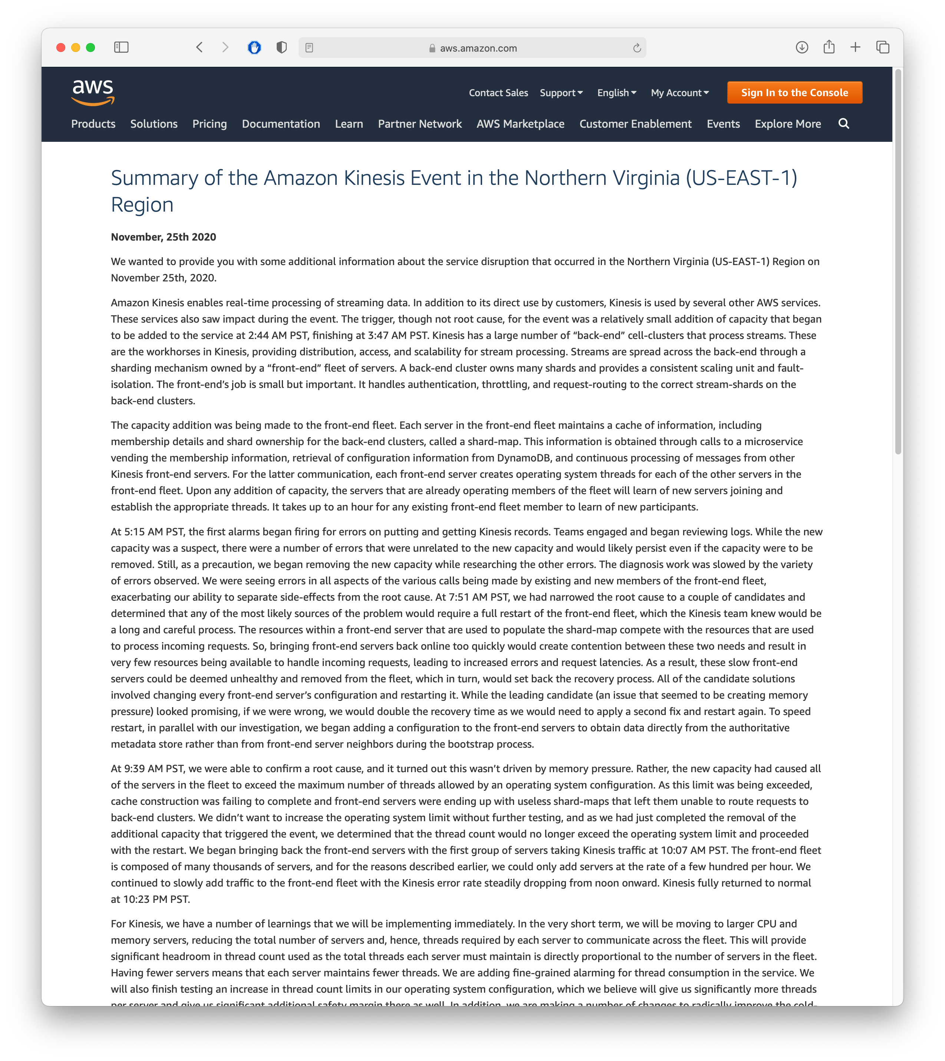
We still rely on other administrators, who are not infallible
Notes:
It is also important to understand that there are even more challenges once we introduce a network, because we become reliant on other administrators and organizations to provide us with an essential service.

Slide 17
CS 4530: Fundamentals of Software Engineering Lesson 9.2: Distributing Data
Jonathan Bell, Adeel Bhutta, Mitch Wand
Khoury College of Computer Sciences
© 2022 Released under the CC BY-SA license

Slide 18
Dealing with Shared Data is a Challenge
Most distributed systems have some shared data
How important is it to:
Retrieve data quickly?
Update data quickly?
Make sure all users see the same data?
Make sure all users can always see (some values of) the data
This all depends on the goals of the system.

Slide 19
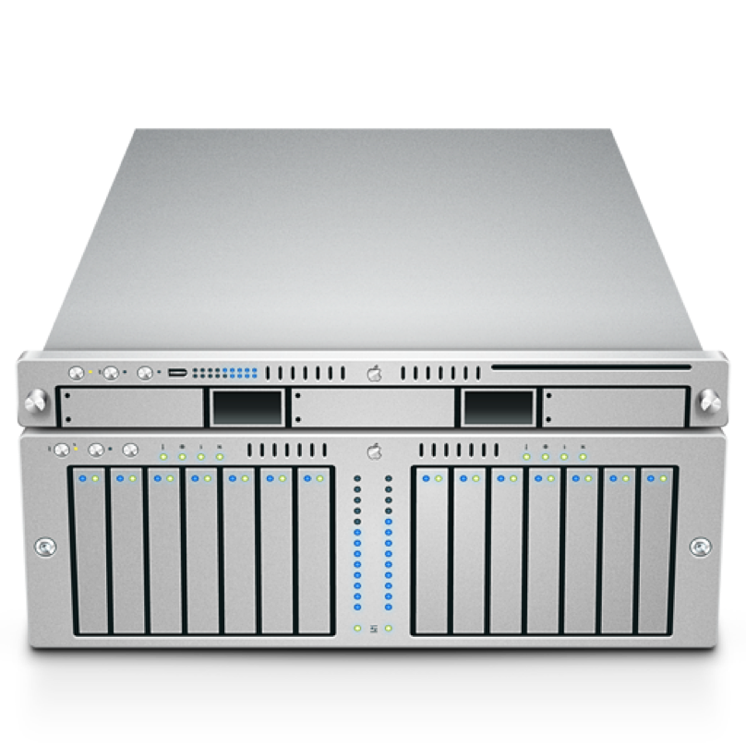

Recurring Problem #1: Too Much Data
In a non-distributed system, all accesses go to a single server.
All accesses go to single server
A
B
Notes:
Partitioning is the simplest strategy that we can employ to improve the scalability of our system. Here is a system that allows the user to retrieve two kinds of data, which we call A and B. This is the non-distributed version, in which all accesses go to a single server.

Slide 20
Recurring Solution #1: Partitioning
Divide up the data in some (hopefully logical) way.
Each server is responsible for only some of the data
A
[0…100]
B [A…N]
A
[101.. 200]
B [O…Z]
Notes:
With partitioning, we divide up data in some (hopefully logical) way. Deciding how to split this data into partitions can be a tricky problem. One easy way to do this is to use some property of the data: if we have 200 records, and they are indexed from 0… 200, you could envision putting the first 100 on one server, and the next 200 on another. Or, split student records by last name: A..N on one server and O..Z on another.
This can improve scalability because we can now process more requests concurrently: each server holds some subset of our data, and if clients want to touch different pieces of that dataset, they can interact with different machines. Even if one server goes down, the rest of the data would still be available.

Slide 21
Partitioning: Advantages
Each server has 50% of the data
Requires less processing power per server
Allows concurrency in reads/writes
Even if one server goes down, still have access to 50% of the data

Slide 22
Partitioning: Challenges
What’s a good way to divide the data?
Depends on the nature of the application
We’ll see this in our case studies

Slide 23
Recurring Problem #2: Too Many Requests
In a non-distributed system, all requests go to a single server.
A
B
Notes:
Partitioning is the simplest strategy that we can employ to improve the scalability of our system. Here is a system that allows the user to retrieve two kinds of data, which we call A and B. This is the non-distributed version, in which all accesses go to a single server.

Slide 24
Recurring Solution #2: Replication
Entire data set is copied
Either server can handle any request
A
B
A
B
Notes:
And replicate it to multiple servers. In this model, our entire service (and all of the data) is replicated across multiple servers. Ideally, either server can process any request. Hence, we can increase the fault tolerance and performance of our system by having multiple machines that can process requests concurrently, and if one fails, the other can continue to process requests. We can even use this scheme to reduce latency, by placing these replicas in geographically diverse areas. If our replica is physically closer to a client, then it will take less time for a request to get to our server, and a response to get back to the client.

Slide 25
Replication: Advantages
Improves performance:
Client load can be evenly shared between servers
Reduces latency: can place copies of data nearer to clients
Improves availability:
One replica fails, still can serve all requests from other replicas

Slide 26
Replication Problem: Consistency
We probably want our system to work like this
Set A=5
“OK”!
Read A
“5”!
A
B
A
B
6
5
7
6
5
7
Notes:
Replication introduces a new problem, which is: consistency.
Consistency means that all nodes in a replicated system see the same data at the same time. When we set A to 5, the 5 appears on all of the replicas at once.

Slide 27
Sequential Consistency is the Ideal
AKA: Behaves like a single machine would
But unattainable!
Set A=5
“OK”!
Read A
“5”!
Set A=5
A
B
A
B
“OK!”
6
5
7
6
5
7
Notes:
How do we implement replication? Let’s see the classic protocol for replicated data between two machines, and maintaining sequential consistency. Sequential consistency is a fancy way of saying, effectively, that clients can read and write data as if they were interacting with a single server, rather than multiple. The property that we need to guarantee is that before we acknowledge the update to 5, we need to ensure that it’s acknowledged by all machines. A simplification of this protocol, then, is: we provisionally update the value to 5, ask the replica to update it, and only once the replica acknowledge the update, we acknowledge it too. Future reads are then guaranteed to see that new value.
We achieved consistency.

Slide 28
Consistent + Available
On timeout, assume node is crashed
Read A
Set A=5
“OK”!
“5”!
Set A=5
Assume replica failed
A
B
A
B
6
5
7
6
7
Notes:
We can ensure consistency and availability at the same time. If we detect that a node is down, we complete the update operation and reroute requests to the live nodes.

Slide 29
What if the network fails?
No way to tell whether it’s the network or the remote machine.
Set A=5
“OK”!
Read A
“6”!
Set A=5
Assume replica failed
A
B
A
B
6
5
7
6
7
Notes:
However what if the connection between the updated node and the replica fails? This is an assumption that we need to keep (our system must tolerate network partition)
Here, we fail to share the updated state, timeout occurs, but the replica is still up and servicing requests.
If we still want to service requests, we assume the replica is down and continue, prioritizing availability and losing consistency.
We could prioritize consistency, but then we would have to stop servicing requests, losing availability.

Slide 30
CAP Theorem: Consistency or Availability
Pick two of three:
Consistency: All nodes see the same data at the same time (strong consistency)
Availability: Individual node failures do not prevent survivors from continuing to operate
Partition tolerance: The system continues to operate despite message loss (from network and/or node failure)
Can’t drop this for a DS - networks can always fail
Notes:
Emphasize: If we want strong consistency, we won’t be able to achieve the availability we might want

Slide 31
Luckily, there are possible compromises
Sacrifice some availability for consistency (eg in a chat system: you want the chats to appear in order)
Sacrifice some consistency for availability (eg you may not care in what order the cats appear)
Or you may want different policies for reads vs. writes.
Doing this is beyond the limits of this course (whew!)

Slide 32
Most distributed systems combine both partitioning and replication
A
A
B
B
Notes:
Of course, most distributed systems combine both partitioning and replication

Slide 33
CS 4530: Fundamentals of Software Engineering Lesson 9.3: Distributing Processing
Jonathan Bell, Adeel Bhutta, Mitch Wand
Khoury College of Computer Sciences
© 2022 Released under the CC BY-SA license

Slide 34
Learning Objectives for this Lesson
By the end of this lesson, you should be able to…
Recognize common software architectures
Understand tradeoffs of scalability, performance, and fault tolerance between these architectures

Slide 35

Distributed Software Architectures
Goal: abstract details away into reusable components
Enables exploration of design alternatives
Allows for analysis of high-level design before implementation
Match system requirements to quality attributes of common architectural patterns
Notes:
In today’s lecture, we will discuss common distributed systems architectures.
(Read slide)
In the same way that object oriented design patterns let us reason about trade-offs in common problems, software architectures let us reason about tradeoffs to common problems, but at a much larger scale.
For example, consider the layout of buildings on campus: determining where to put what building and how people flow between them is an important step of design.

Slide 36


Review: Distributed Systems Must Compromise
Constraints: number of nodes, network links
SF
NY
Even if cross-city links are fast and cheap (are they?)
Still that pesky speed of light…
DC
LONDON
Notes:
For large, complex systems, the architectures must inevitably involve some compromise. As we discussed in the last module, even with infinity resources, there will still be fundamental limitations to our system’s performance.
In summary: the key challenges that distributed systems need to design around are:
greater potential to see at least one component fail (given independent failure probabilities and increase in number of components)
Now we can also see the network link fail (not just a machine fail)
Limited high-speed networks between sites (limited throughput)
Speed of light

Slide 37
Replicated Systems Must Compromise
Consistency or availability?
Consistent:
Maintain that “single server” behavior - all clients see the same values regardless of failures
At least one server can’t safely respond in case of failure
Available:
Different servers might diverge
Ignores network failures, as long as client can reach server, still offer a response
A
B
A
B
Notes:
Particularly when our distributed systems involve replication, we also discussed the challenge that they must make between consistency: Maintaining that “single server” behavior - all clients see the same values regardless of failures - and availability: allowing all nodes to continue operating in the presence of a single failure.
Remember: DNS makes the compromise that it is OK to see the wrong value.
Software architectures will let us see common solutions to the question of how to structure our system, given different goals.

Slide 38
The Monolith Architecture Relies on a Single Server
Simplest answer to consistency problem: have only one server, one source of truth
Still “distributed” in that we have many clients
Sacrifices:
Scalability
Performance
Fault tolerance
Server
Client
Client
Client
Client
Client
Notes:
While most distributed systems involve multiple “servers” coordinating to act as one, it is also worthwhile to consider the case of a single server interacting with multiple clients. When considering the system as a whole: the clients *and* the server, there is still some coordination that occurs to implement the system’s goals. We will start with discussing this “monolithic” application as a starting point for examining other common distributed systems architectures.
(Read slide, next slide will have example of a monolithic design and its faults)

Slide 39
Monolithic Architectures Struggle to Scale
Scalability - How to go from 10 to 100 to 1,000 clients?
Performance - How to access 100’s of GB of data concurrently?
Fault tolerance - What if server crashes?
Server
Client
Client
Client
Client
Client
Notes:
While the monolithic architecture of NFS is certainly applicable to many use-cases (it is very widely used!), there are limitations to this architecture.
To scale a monolith (like NFS), our single option is to replace our server with a bigger server. Eventually, we will reach a limit of the performance of a single server. By definition, the monolith has a single server, so to break this scaling barrier, we will need a new architecture.
Similarly, the performance of the monolith is limited by the performance of that single node and its network links. If, in this figure, we have 5 clients all trying to read 100GB files concurrently, they will be limited by the total throughput of this one server.
Lastly, we will be quite limited in terms of a fault tolerance story here. If the single server goes down, the whole system goes down.

Slide 40
Replication Alone is Not The Answer
Constraints:
Latency: Speed of light (~1ns/ft)
Throughput: Long-distance links between servers are relatively low throughput (10’s of Gbps, compare to 100’s of Gbps within a single server)
Tradeoffs for replication, particularly over long distances:
Replication will add latency, not reduce it
Usually not enough bandwidth to maintain replication of all data across all nodes
Notes:
To motivate the next architecture that we will discuss, recall two of the constraints in distributed systems from the last module: latency and throughput.
These constraints impose significant tradeoffs for architectures that rely on replication, particularly over long distances.
First: Since replication (with consistency) requires that updates are made to all servers that maintain a replica of that data, replication *adds* latency to reads or writes by requiring that updates are acknowledged by all replicas before committing them.
Second: Given limited network throughput, there is often not enough bandwidth to maintain replication of all data across all nodes.
As a result, most distributed system architectures consider both replication and partitioning.

Slide 41
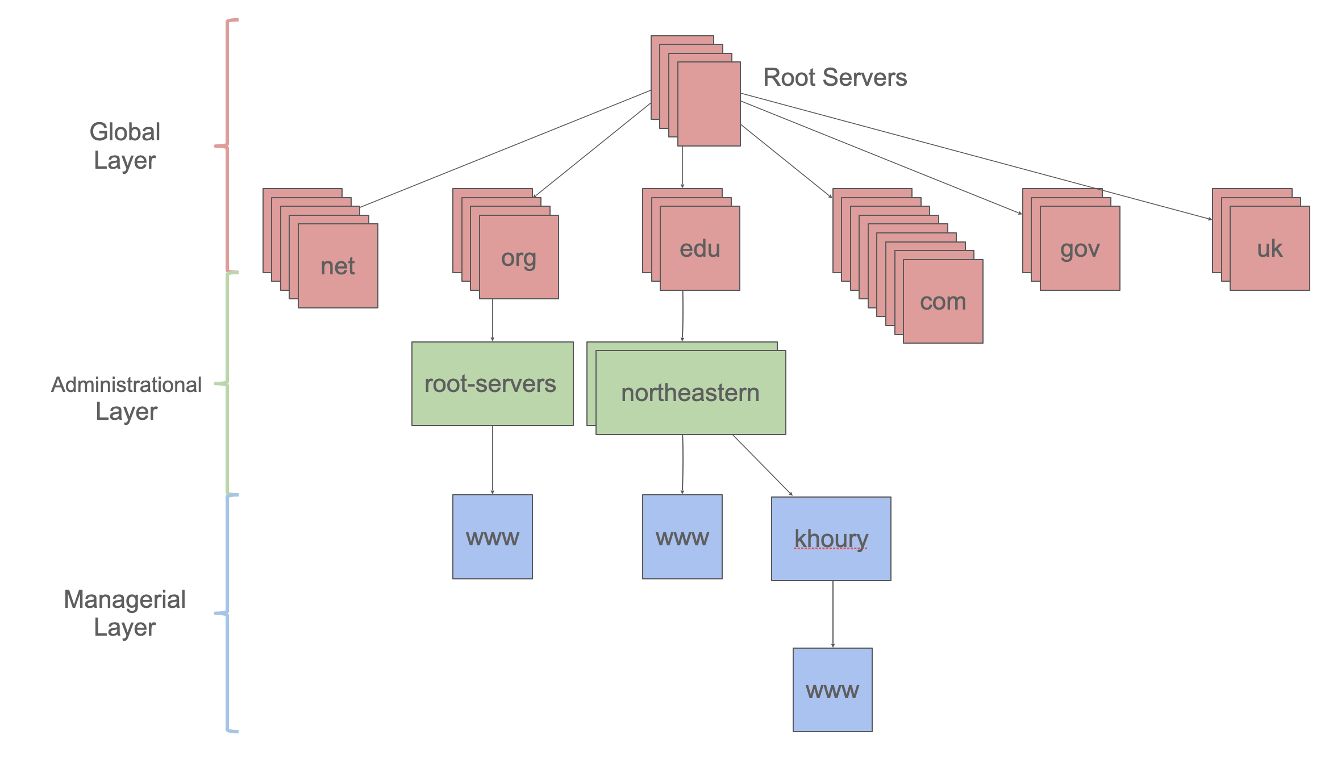
Tiered Architectures
Key idea: Partition the system into distinct tiers based on responsibilities
Each tier scales independently of the others - .com need not know about .org
Satisfying a single request may require multiple tiers
DNS is a tiered architecture
Example: scale .com differently from .gov
Notes:
DNS, which we discussed in the last module, is an example of what we call a “tiered” architecture.
(Read slide)

Slide 42
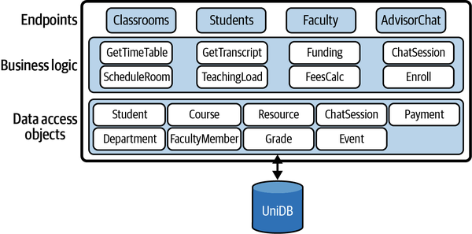
Example of tiered architecture (maybe)

Slide 43
Pipeline Architectures
The pieces correspond to stages in the transformation of data in the system
Good for complex straight-line processes where multiple stages applied to different data, concurrently
Each stage in the pipeline takes an input, produces an output: otherwise stateless
Example: Map/Reduce splits data, filters it through stages, then combines
Pipeline architecture allows flexibility in mapping stages to physical servers
Big Data (lots of work)
Partition
Stage 1
Stage 1
Stage 1
Stage 1
Stage 1
Stage 2
Stage 2
Stage 2
Stage 2
Stage 2
Stage 3
Stage 3
Stage 3
Stage 3
Stage 3
Combine
Result
Notes:
(Read slide; note that figure on right is map/reduce architecture, showing pipeline through stages. Each stage might be on a different server, or they could be on the same. The abstraction says it doesn’t really matter.)

Slide 44
Pipeline Architectures
Scalability/Performance:
Add more machines to process more data in parallel
Limited by bandwidth to transfer inputs/outputs between stages
Fault tolerance: Each stage in pipeline is stateless. If one fails, it can be repeated elsewhere.
Big Data (lots of work)
Partition
Stage 1
Stage 1
Stage 1
Stage 1
Stage 1
Stage 2
Stage 2
Stage 2
Stage 2
Stage 2
Stage 3
Stage 3
Stage 3
Stage 3
Stage 3
Combine
Result
Notes:
How does a pipeline architecture address our distributed systems requirements and tradeoffs?
Similarly to the tiered architecture, we can scale to support processing more data concurrently by adding more machines. Each machine can process some number of stages concurrently. Because the stages are independent, we can always add more machines to process more data in parallel.
The limitation that we will run into is the bandwidth to transfer the inputs and outputs from each stage in the pipeline to the next.
However, once we recognize this limitation, we can also design systems around it: consider this exact problem of map/reduce running on a lot of data. How do we move that big amount of data to be in the right spot to run a task on it? Map/Reduce is implemented in conjunction with GFS: each filter in the pipeline is run on a chunk server that already has that piece of data.
In terms of fault tolerance, the pipeline architecture improves over the general tiered architecture because it also enforces the requirement that each stage in a pipeline is stateless. If a node fails in the middle of processing some data in a stage of the pipeline, the system could always recover by running that same input through the pipeline again: no data would become corrupted by partial results from the failed computation.

Slide 45
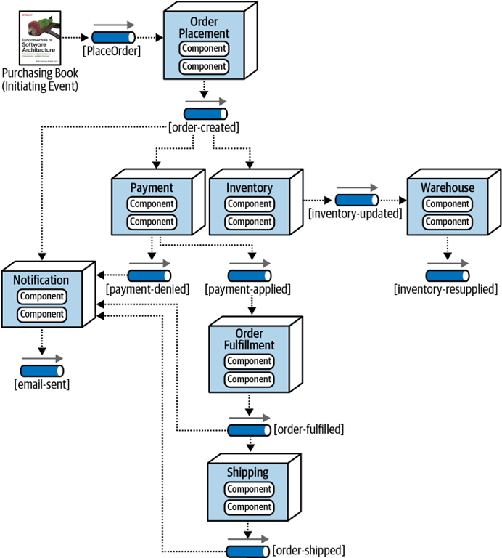
Event-Driven Architectures
Metaphor: a bunch of bureaucrats shuffling papers
Components correspond to stages in the flow of data through the system (not necessarily a straight-line flow)
Very useful for composing other services (bureaucrats)
Each processing unit has an in-box and one or more out-boxes
Each unit takes a task from its inbox, processes it, and puts the results in one or more outboxes.
Stages are typically connected by asynchronous message queues.
Can scale each component independently
Notes:
(Read slide)

Slide 46
Event-Driven Architecture Tradeoffs
Scalability:
Scale each processing unit separately
Add more processing units at a marginal cost
Performance:
Message queue usually very high-throughput, relies on event processors to pick up and process messages or queue can overflow
Fault tolerance:
Message queue can implement a buffer to ensure fault tolerance
Notes:
(Read slide)

Slide 47
Microservice Architectures
Organize implementation around components (responsibilities)
Each component is implemented independently
Each component is
independently replaceable,
independently updatable
Components can be built as libraries, but more usually as web services
Services communicate via well-defined protocol like REST (to be covered soon)
Mitch says: what is the difference between an event-driven architecture, as described above, and a microservice architecture?
Notes:
(Read slide)

Slide 48
Microservices: Schematic Example
Different languages, different operating systems
NodeJS, MongoDB
Google Service
Java, MySQL
Todos
Logins
Mailer
Mod 1
Mod 2
Mod 3
REST service
REST service
REST service
Productivity App
Database
Database
Database
Frontend
REST
Search Engine
Analytics
Social Crawler
“Dumb”
App Server
Mod 4
Mod 5
Mod 6
REST service
REST service
REST service
Database
Database
Database
Java, Neo4J
C#, SQLServer
Python, MongoDB
Notes:
Here is an example of a micro services architecture for a productivity application. There are multiple components to this application. Each component is shown as a grey box, and is a micro service.
(Note the separation of responsibilities to entirely different services that only connect over a well-defined API)
Common question: How is this different from the event-based system? A: Picture looks very similar. Difference is that the services communicate directly with each other over a well-defined API, rather than having a message queue that routes the messages to the different services.

Slide 49
Microservice Advantages and Disadvantages
Advantages
services may scale differently, so can be implemented on hardware appropriate for each (how much cpu, memory, disk, etc?). Ditto for software (OS, implementation language, etc.)
services are independent (yay for interfaces!) so can be developed and deployed independently
Disadvantages
service discovery?
should services have some organization, or are they all equals?
overall system complexity

Slide 50
Microservices are (a) highly scalable and (b) trendy
Microservices at Netflix:
100s of microservices
1000s of daily production changes
10,000s of instances
BUT:
only 10s of operations engineers
https://medium.com/refraction-tech-everything/how-netflix-works-the-hugely-simplified-complex-stuff-that-happens-every-time-you-hit-play-3a40c9be254b

Slide 51
Microservices vs Monoliths
higher is better
https://martinfowler.com/microservices/
Notes:
It is hard to say generally when it makes sense to create a micro service architecture vs a more monolithic one. For very simple systems, the micro service architecture might simply be adding complexity. But, theoretically, as the system grows in complexity, the micro service abstraction improves understanding and productivity

Slide 52
CS 4530: Fundamentals of Software Engineering Lesson 9.4: Case Studies
Jonathan Bell, Adeel Bhutta, Mitch Wand
Khoury College of Computer Sciences
© 2022 Released under the CC BY-SA license

Slide 53
Example: Domain Name System (DNS)
Nodes (hosts) on a network are identified by IP addresses
E.g.: 142.251.41.4
We humans prefer something easier to remember: calendar.google.com, facebook.com, www.khoury.northeastern.edu
We need to keep a directory of domain names and their addresses
We also need to make sure everybody gets directed to the correct host
Notes:
Our case study today will be the domain names system.
(Read slide)

Slide 54
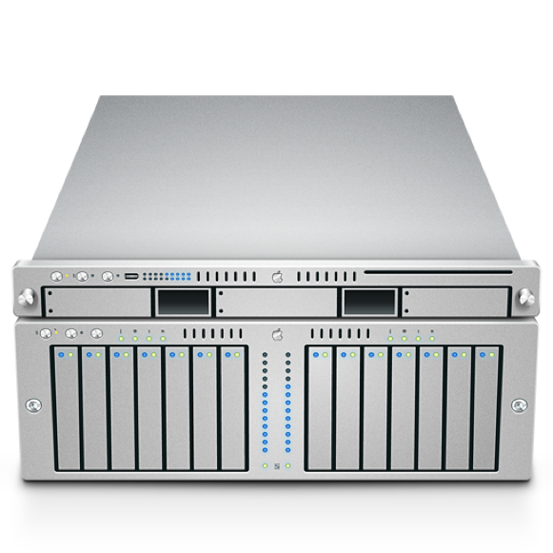

Example: Domain Name System (DNS)
Need to handle millions of DNS queries per second
Not immediately obvious how to scale: how do we maintain replication, some measure of consistency?
DNS Server
facebook.com?
31.13.66.35
Notes:
As just mentioned, a primary goal for needing to expand to distributed systems is scale. This is certainly true for DNS.
(Read slide)

Slide 55
Strawman solution: Use a local file
Keep local copy of mapping from all hosts to all IPs (e.g., /etc/hosts)
Space requirements are feasible now
IPv4 space is now full
32-bits: 4,294,967,296 addresses
At 1 byte per address, file would be 4GB
Not a lot of disk space now, but DNSwas introduced in the late 80s.
BUT hosts change IPs regularly, so need to download file frequently
Lot of constant internet bandwidth use
Not scalable!
Notes:
Before we get to the distributed solution, let’s examine a strawman solution. Keep a copy of all of DNS locally on each computer. Since IPs change regularly -> We can keep the file up to date by syncing it with a remote version.
(Read slide)

Slide 56
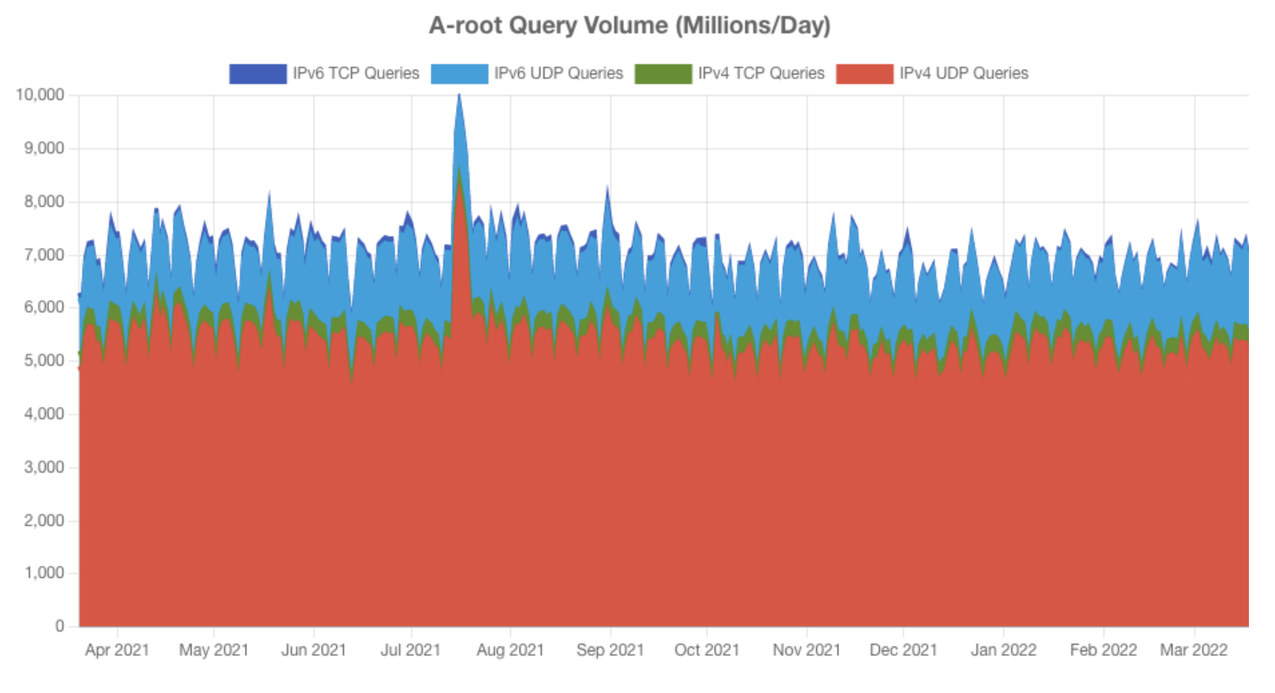
Another Strawman: Well-known centralized server.
All requests made to this server:
Single point of failure
Bottleneck for throughput and access time
Bottleneck for administration (adding/changing records?)
Ultimately, not scalable!
https://a.root-servers.org/metrics
Notes:
Here is another strawman: instead of having all of the DNS information replicated to every computer, we could have a single, well-known centralized server.
The graphic on the right shows a small portion of DNS traffic worldwide (less than 15% of all traffic, and only considering top-level .com traffic). It is quite a few queries per day - note that the graph is labeled in thousands, but those are really thousands of millions of requests per day (aka billions)
(Read slide)

Slide 57
DNS distributed system goals
We need a scalable solution
New hosts keep being added
Number of users increases
Need to maintain speed/responsiveness
We need our service to be available and fault tolerant
It is a crucial basic service
A problematic node shouldn’t “crash the internet”
Reads are more important that writes: far more queries to resolve records than to update them
Global in scope
Domain names mean the same thing everywhere
Notes:
It should now be increasingly apparent why DNS is a case study in distributed systems design. It is a system that must scale. As we will see, the *requirements* of a system will greatly influence our design choices. Here are the requirements for DNS:
(Read slide)

Slide 58
How to organize DNS
Idea: break apart responsibility for each part of a domain name (zone) to a different group of servers
Each zone is a continuous section of the name space, eg *.northeastern.edu
Each zone has an associated set of name servers.

Slide 59
Partitioning DNS
Root Servers
Global
Layer
net
org
edu
com
gov
uk
Administrational
Layer
root-servers
northeastern
www
www
khoury
Managerial
Layer
www
Notes:
DNS partitions responsibility by “layers”. In this simplified view, we show a single server responsible for each layer. In practice, each layer might be its own distributed system!
Let’s see how this partitioning is useful in an example that demonstrates how to resolve a name to an address (on next slide)

Slide 60
The servers are organized into a tree
Every computer has a connection to a DNS server that it gets from its internet provider.
Each DNS server has its parent server.
If I want to direct my browser to course.khoury.northeastern.edu, I ask my DNS server.

Slide 61
Here is a request for ‘course.khoury.neu.edu’.
The request goes to the local DNS server, which asks its root server for the IP address.
The Root server replies: “go ask the server for .edu”.
So the local server asks the server for .edu . The .edu server says “go ask the server for .neu.edu”. And so on, until the local server asks the server for .khoury.neu.edu, which knows the address for course.khoury.neu.edu, and sends it to the local server, which tells it to the nice machine that was originally asking for it.

Slide 62
DNS: Example
What might a request look like in practice?
Root
Local DNS Server
course.khoury.neu.edu
course.khoury.neu.edu
ns.edu
.edu
129.10.117.35
course.khoury.neu.edu
ns1.neu.edu
course.khoury.neu.edu
neu.edu
129.10.117.35
ns1.khoury.neu.edu
129.10.117.35
course.khoury.neu.edu
khoury.neu.edu
Notes:
Here is a request for ‘course.khoury.neu.edu’. The request goes to the local DNS server, which asks its root server for the IP address. The Root server replies: “go ask the server for .edu”.
So the local server asks the server for .edu . The .edu server says “go ask the server for .neu”. And so on, until the local server asks the server for .khoury.neu.edu, which knows the address for course.khoury.neu.edu, and sends it to the local server, which tells it to the nice blue machine that was originally asking for it.

Slide 63
This is an example of a tiered architecture
Each server need only needs to know about its immediate descendants in its zone.
It only processes requests about a single zone.
Both data and processing are limited to requests about this zone– any other requests are delegated to this server’s parent server.

Slide 64
But some zones are too big and too busy to be handled by a single server
Eg, .edu, .com, .gov, etc.
So these servers are replicated.

Slide 65
Replication in DNS – Root Servers
Verisign, Inc. | a
Information Sciences Institute | b
Cogent Communications | c
University of Maryland | d
NASA Ames Research Center | e
Internet Systems Consortium, Inc. | f
U.S. DOD Network Information Center | g
U.S. Army Research Lab | h
Netnod | i
Verisign, Inc. | j
RIPE NCC | k
ICANN | l
WIDE Project | m
13 root servers
[a-m].root-servers.org
E.g., d.root-servers.org
Handled by 12 distinct entities
(“a” and “j”) are both Verisign
Don’t ask why.

Slide 66
There is replication even within the root servers
13 root servers
[a-m].root-servers.org
E.g., d.root-servers.org
But each root server has multiple copies of the database, which need to be kept in sync.
Somewhere around 1500 replicas in total.

Slide 67
Example: NFS, the Network File System
In a UNIX (POSIX-compliant) operating system, files are stored in a tree from “/”
“Mount” multiple filesystems to access them locally
Filesystems could be directly attached to this computer, or shared by a remote server
NFS is a distributed file system: multiple clients can read/write the same files
Created in 1984, still widely used
Internal HD
/
Volumes
Users
externalHD
neuHome
jon
…
…
External HD
Remote Server (NFS)
Notes:
(Read slide – note there are multiple file systems, including one that is shared by NFS)

Slide 68
NFS is a Monolithic Shared Filesystem
All files are stored on a single server
To list files in a directory, clients make request to server
To read or write files, clients make request to server
Clients might “lock” files to prevent concurrent updates
Assuming that scale, throughput, fault tolerance requirements are relatively low, this is an acceptable architecture
This architecture is the easiest to build fast and correctly
Notes:
To summarize how NFS is a “monolithic system”:
(Read slide)

Slide 69
Example: GFS (Google File System, ~2010)
Stated requirements:
“High sustained bandwidth is more important than low latency. Most of our target applications place a premium on processing data in bulk at a high rate, while few have stringent response time requirements for an individual read or write.”
Notes:
How might we consider applying this idea of partitioning to a network filesystem, like our NFS monolith?
A classic example of tiering distributed filesystems is GFS, the Google File System.
(Read stated requirements)
The key problem is that the throughput of a single server is limited, so we need some way to have multiple servers, so that clients can read/write files on those different servers, allowing for scaling. But how do we coordinate multiple servers?

Slide 70
GFS Tiers Filesystem: Metadata and File Chunks
Example: GFS (Google File System, c 2010)
Where is file /foo/bar?
GFS Client
GFS Metadata
List of chunks and their locations
Metadata tier stores where files are stored, in 128MB chunks
GFS Client
GFS Client
GFS Client
Reads chunks from the specific ChunkServers known to have them
GFS Client
GFS Client
GFS Client
ChunkServer
ChunkServer
ChunkServer
ChunkServer
ChunkServer
ChunkServer
ChunkServer
ChunkServer
ChunkServer
ChunkServer
Chunk tier stores each 128MB chunk, no need for coordination between ChunkServers not storing same chunk
ChunkServer
ChunkServer
ChunkServer
ChunkServer
ChunkServer
ChunkServer
ChunkServer
ChunkServer
ChunkServer
ChunkServer
ChunkServer
ChunkServer
ChunkServer
ChunkServer
Notes:
To achieve these stated requirements, GFS’ architecture is split into two tiers.
Each file is split into multiple “chunks” of 128MB. A GFS Metadata tier, which knows the names of each of the files, and for each file, knows where the “chunks” are.
The Chunk tier stores each of the 128MB chunks.
For a client to read a file, like “/foo/bar”, it first asks the metadata tier for the list of chunks and the chunk servers that have it. Then, it can directly connect to the relevant chunk servers in the chunk tier and read the file.
The chunk tier can scale extremely efficiently, because supporting more (and bigger) concurrent reads/writes just means that we add more chunk servers. This tiering can be further expanded so that chunks are replicated between multiple chunk servers, creating yet another tier, but getting into the details of GFS further is really the topic of a distributed systems class.
Of course: there might be a bottleneck on the metadata tier: every single request will pass through it (to find which chunk server to talk to). But: the requirements stated that it was OK for there to be a latency to start a large read or write - so this is an adequate design for the requirements. Within Google, GFS has since been replaced by a much more complex system that alleviates this bottleneck, but this design is widely deployed today - the very popular “Hadoop” map/reduce library implements a distributed filesystem “HDFS” which is exactly this one!
Our important takeaway for GFS is that it allows for high-throughput reads and writes by allowing this “chunk” tier to scale with little limitation.

Slide 71
Example: Reliable Real-Time Chat
Requirements: “Must support real-time text chat for 2,000 users exchanging messages. Must have best-effort delivery in real-time, and guarantee that all messages acknowledged are preserved.”
Challenge: Real-time “best-effort” delivery has conflicting requirements (low latency at expense of fault tolerance) with guaranteeing all messages are eventually delivered (fault tolerance at expense of latency)
Notes:
Event driven architectures are very useful to compose multiple systems together that have different requirements.
For example: How do we design a system like Slack, which needs to support real-time text chat for potentially thousands of users in the same channel. We want those message to be delivered in real-time (with the least possible latency), but will accept potential failures: if some client is slow to respond to acknowledge a message, we should still keep sending the message to the rest of the clients. But, at the same time, we want to ensure that we have an authoritative record that guarantees that all of the chat messages in a channel are recorded in the order in which they were received, with fault tolerance?
These are conflicting requirements. Building one system that does both things seems impossible.
This is where the idea of an event-driven architecture comes into play

Slide 72
Event Driven Architecture: Reliable Real-Time Chat
Requirements: “Must support real-time text chat for 2,000 users exchanging messages. Must have best-effort delivery in real-time, and guarantee that all messages acknowledged are preserved.”
Allocate separate processing units for these requirements:
“Real time” component optimizes for speed and availability (sacrificing fault-tolerance)
“Persistence” component optimizes for fault-tolerance, sacrificing speed and availability
Event queue service receives events, dispatches to both processing units and is fault tolerant
Notes:
The core concept of event-driven architectures is to separate responsibilities (or tiers, if you will) by processing units. We can take these two conflicting requirements and organize them into two processing units around these responsibilities:
Real time processing unit optimizes for speed and availability of distributing all messages in real time to as many clients as possible. It makes no fault tolerance guarantees - if parts of it fail, clients will not get their messages in real time. However, the clients could still retrieve them (perhaps somewhat slower) from…
Persistence processing unit, which optimizes for fault-tolerance, sacrificing speed and availability. Every message that is received by the persistence processing unit is guaranteed to be available in the future if clients ask for it.
By using the pattern of an event-driven architecture, we can then add an event queue service that receives the chat messages from clients and dispatches them to both processing units. The event queue will be fault tolerant in that it has a buffer of messages that have been received, but not yet processed by the “persistence” component. As the persistence component archives the messages, the buffer can be freed.

Slide 73
Event Driven Architecture: Reliable Real-Time Chat
Real Time Chat Service
Client
Fast, not-fault-tolerant real-time service (e.g. Redis)
Client
Reliable message queue (e.g. RabbitMQ)
Client
Reliable database (e.g. PostgreSQL)
Client
Notes:
Here is a high-level architecture diagram that shows how we might go about implementing this real time chat service.
Messages flow into our system, and are delivered to both components - the real time service and the persistence service.
We do not show the details of how each of the components is implemented (that’s a topic for another class), but list an example of the kinds of off-the-shelf infrastructure that are likely to be used by each component (RabbitMQ – Rabbit M Q; Redis (read-iss); Postgres (Post-Grehs). Each of those components might be a single server, or a cluster of services. Hooray for abstractions!

Slide 74
CS 4530 Software Engineering
Module 10: Distributed Systems Architectures
Jonathan Bell, Adeel Bhutta, Mitch Wand
Khoury College of Computer Sciences
© 2022, released under CC BY-SA

Slide 75
NFS is the Network File System
In a UNIX (POSIX-compliant) operating system, files are stored in a tree from “/”
“Mount” multiple filesystems to access them locally
Filesystems could be directly attached to this computer, or shared by a remote server
NFS is a distributed file system: multiple clients can read/write the same files
Created in 1984, still widely used
Internal HD
/
Volumes
Users
externalHD
neuHome
jon
…
…
External HD
Remote Server (NFS)
Notes:
(Read slide – note there are multiple file systems, including one that is shared by NFS)

Slide 76
NFS is a Monolithic Shared Filesystem
All files are stored on a single server
To list files in a directory, clients make request to server
To read or write files, clients make request to server
Clients might “lock” files to prevent concurrent updates
Assuming that scale, throughput, fault tolerance requirements are relatively low, this is an acceptable architecture
This architecture is the easiest to build fast and correctly
Notes:
To summarize how NFS is a “monolithic system”:
(Read slide)

Slide 77
Design Tiers Considering the Structure of Data
Example: GFS (Google File System, c 2010)
Stated requirements: “High sustained bandwidth is more important than low latency. Most of our target applications place a premium on processing data in bulk at a high rate, while few have stringent response time requirements for an individual read or write.”
Server
Key problem: throughput of single server is limited
Client
Client
Client
Client
Client
Notes:
How might we consider applying this idea of partitioning to a network filesystem, like our NFS monolith?
A classic example of tiering distributed filesystems is GFS, the Google File System.
(Read stated requirements)
The key problem is that the throughput of a single server is limited, so we need some way to have multiple servers, so that clients can read/write files on those different servers, allowing for scaling. But how do we coordinate multiple servers?

Slide 78
GFS Tiers Filesystem Metadata and File Chunks
Stated requirements: “High sustained bandwidth is more important than low latency. Most of our target applications place a premium on processing data in bulk at a high rate, while few have stringent response time requirements for an individual read or write.”
Where is file /foo/bar?
GFS Client
GFS Metadata
List of chunks and their locations
Metadata tier stores where files are stored, in 128MB chunks
GFS Client
GFS Client
GFS Client
Reads chunks from the specific ChunkServers known to have them
GFS Client
GFS Client
Chunk tier stores each 128MB chunk, no need for coordination between ChunkServers not storing same chunk
GFS Client
ChunkServer
ChunkServer
ChunkServer
ChunkServer
ChunkServer
ChunkServer
Example: GFS (Google File System, c 2010)
ChunkServer
ChunkServer
ChunkServer
ChunkServer
ChunkServer
ChunkServer
ChunkServer
ChunkServer
ChunkServer
ChunkServer
ChunkServer
ChunkServer
ChunkServer
ChunkServer
ChunkServer
ChunkServer
ChunkServer
ChunkServer
Notes:
To achieve these stated requirements, GFS’ architecture is split into two tiers.
Each file is split into multiple “chunks” of 128MB. A GFS Metadata tier, which knows the names of each of the files, and for each file, knows where the “chunks” are.
The Chunk tier stores each of the 128MB chunks.
For a client to read a file, like “/foo/bar”, it first asks the metadata tier for the list of chunks and the chunk servers that have it. Then, it can directly connect to the relevant chunk servers in the chunk tier and read the file.
The chunk tier can scale extremely efficiently, because supporting more (and bigger) concurrent reads/writes just means that we add more chunk servers. This tiering can be further expanded so that chunks are replicated between multiple chunk servers, creating yet another tier, but getting into the details of GFS further is really the topic of a distributed systems class.
Of course: there might be a bottleneck on the metadata tier: every single request will pass through it (to find which chunk server to talk to). But: the requirements stated that it was OK for there to be a latency to start a large read or write - so this is an adequate design for the requirements. Within Google, GFS has since been replaced by a much more complex system that alleviates this bottleneck, but this design is widely deployed today - the very popular “Hadoop” map/reduce library implements a distributed filesystem “HDFS” which is exactly this one!
Our important takeaway for GFS is that it allows for high-throughput reads and writes by allowing this “chunk” tier to scale with little limitation.

Slide 79
Event Driven Architecture: Reliable Real-Time Chat
Requirements: “Must support real-time text chat for 2,000 users exchanging messages. Must have best-effort delivery in real-time, and guarantee that all messages acknowledged are preserved.”
Challenge: Real-time “best-effort” delivery has conflicting requirements (low latency at expense of fault tolerance) with guaranteeing all messages are eventually delivered (fault tolerance at expense of latency)
Client
Client
Sends message
Real Time Chat Service
Delivers instantly to 2,000 clients
Client
Client
Notes:
Event driven architectures are very useful to compose multiple systems together that have different requirements.
For example: How do we design a system like Slack, which needs to support real-time text chat for potentially thousands of users in the same channel. We want those message to be delivered in real-time (with the least possible latency), but will accept potential failures: if some client is slow to respond to acknowledge a message, we should still keep sending the message to the rest of the clients. But, at the same time, we want to ensure that we have an authoritative record that guarantees that all of the chat messages in a channel are recorded in the order in which they were received, with fault tolerance?
These are conflicting requirements. Building one system that does both things seems impossible.
This is where the idea of an event-driven architecture comes into play

Slide 80
Event Driven Architecture: Reliable Real-Time Chat
Requirements: “Must support real-time text chat for 2,000 users exchanging messages. Must have best-effort delivery in real-time, and guarantee that all messages acknowledged are preserved.”
Responsibilities/processing units:
“Real time” component optimizes for speed and availability sacrificing fault-tolerance
“Persistence” component optimizes for fault-tolerance, sacrificing speed and availability
Event queue service receives events, dispatches to both processing units and is fault tolerant
Notes:
The core concept of event-driven architectures is to separate responsibilities (or tiers, if you will) by processing units. We can take these two conflicting requirements and organize them into two processing units around these responsibilities:
Real time processing unit optimizes for speed and availability of distributing all messages in real time to as many clients as possible. It makes no fault tolerance guarantees - if parts of it fail, clients will not get their messages in real time. However, the clients could still retrieve them (perhaps somewhat slower) from…
Persistence processing unit, which optimizes for fault-tolerance, sacrificing speed and availability. Every message that is received by the persistence processing unit is guaranteed to be available in the future if clients ask for it.
By using the pattern of an event-driven architecture, we can then add an event queue service that receives the chat messages from clients and dispatches them to both processing units. The event queue will be fault tolerant in that it has a buffer of messages that have been received, but not yet processed by the “persistence” component. As the persistence component archives the messages, the buffer can be freed.

Slide 81
Event Driven Architecture: Reliable Real-Time Chat
“Real time” component optimizes for speed and availability sacrificing fault-tolerance
“Persistence” component optimizes for fault-tolerance, sacrificing speed and availability
Reliable message queue buffers new chat messages
Real Time Chat Service
Client
Client
Sends message
Reliable message queue (e.g. RabbitMQ)
Fast, not-fault-tolerant real-time service (e.g. Redis)
Delivers instantly to 2,000 clients
Client
Reliable database (e.g. PostgreSQL)
Client
Notes:
Here is a high-level architecture diagram that shows how we might go about implementing this real time chat service.
Messages flow into our system, and are delivered to both components - the real time service and the persistence service.
We do not show the details of how each of the components is implemented (that’s a topic for another class), but list an example of the kinds of off-the-shelf infrastructure that are likely to be used by each component (RabbitMQ – Rabbit M Q; Redis (read-iss); Postgres (Post-Grehs). Each of those components might be a single server, or a cluster of services. Hooray for abstractions!

Slide 82
How Do Components/Services Communicate?
Ideally, a magic abstraction: remote procedure call (RPC) should make the separation transparent
There are many variations of RPC
CORBA, RMI, SOAP, and more
The most common form of RPC today is called REST
Caller Machine
Callee Machine
User Code
User Code
local call
local call
work
local return
local return
Notes:
(Read slide)

Slide 83
REST vs. Sockets

Slide 84
REST: Representational State Transfer
Defined by Roy Fielding in his 2000 Ph.D. dissertation
“Throughout the HTTP standardization process, I was called on to defend the design choices of the Web. That is an extremely difficult thing to do... I had comments from well over 500 developers, many of whom were distinguished engineers with decades of experience. That process honed my model down to a core set of principles, properties, and constraints that are now called REST.”
Not just a transport protocol, not a protocol definition language: a design philosophy
Interfaces that follow REST principles are called RESTful

Slide 85


REST Principles
Single Server - As far as the client knows, there’s just one
Stateless - Each request contains enough information that a different server could process it (if there were multiple…)
Uniform Cacheability - Each request is identified as cacheable or not.
Uniform Interface - Standard way to specify interface
Clients
External Cache
Internal Cache
Web Servers
Client sees none of this!
Misc Services
App Servers
Database servers

Slide 86

“Not cacheable” means that it must be executed exactly once per user request.
For example, POST is typically not cacheable

Slide 87
Uniform Interface: Nouns are represented as URIs
In a RESTful system, the server is visualized as a store of resources (nouns), each of which has some data associated with it.
URIs represent these resources
Examples:
/cities/losangeles
/transcripts/00345/graduate (student 00345 has several transcripts in the system; this is the graduate one)
Anti-examples:
/getCity/losangeles
/getCitybyID/50654
/Cities.php?id=50654
We prefer plural nouns for toplevel resources, as you see here.
Useful heuristic: if you were keeping this data in a bunch of files, what would the directory structure look like?
But you don't have to actually keep the data in that way.

Slide 88
Uniform Interface: Verbs are represented as http methods
In REST, there are four things you can do with a resource
POST: requests the server to create a resource
there are several ways in which the value for the new resource can be transmitted (more In a minute)
GET: requests the server to respond with a representation of the resource
PUT: requests the server to replace the value of the resource by the given value
DELETE: requests the server to delete the resource

Slide 89
You say you want parameters?
There are at least 3 ways to associate parameters with a request:
path parameters. These specify portions of the path to the resource. For example, your REST protocol might allow a path like
/transcripts/00345/graduate
query parameters. These are part of the URI and are typically used as search items. For example, your REST protocol might allow a path like
/transcripts/graduate?lastname=covey&firstname=avery
body parameters. You can put additional parameters or information in the body, using any coding that you like.

Slide 90
Example interface #1: a todo-list manager
Resource: /todos
GET /todos - get list all of my todo items
POST /todos - create a new todo item (data in body)
Resource: /todos/:todoItemID
:todoItemID is a path parameter
GET /todos/:todoItemID - fetch a single item by id
PUT /todos/:todoItemID - update a single item (new data in body)
DELETE /todos/:todoItemID - delete a single item

Slide 91
Example Interface #2: a database of transcripts
Remember the heuristic: if you were keeping this data in a bunch of files, what would the directory structure look like?
POST /transcripts
-- adds a new student to the database,
-- returns an ID for this student.
-- requires a body parameter 'name', url-encoded (eg name=avery)
-- Multiple students may have the same name.
GET /transcripts/:ID
-- returns transcript for student with given ID. Fails if no such student
DELETE /transcripts/:ID
-- deletes transcript for student with the given ID, fails if no such student POST /transcripts/:studentID/:courseNumber
-- adds an entry in this student's transcript with given name and course.
-- Requires a body parameter 'grade', url-encoded
-- Fails if there is already an entry for this course in the student's transcript
GET /transcripts/:studentID/:courseNumber
-- returns the student's grade in the specified course.
-- Fails if student or course is missing.
GET /studentids?name=string
-- returns list of IDs for student with the given name
Didn't seem to fit the model, sorry

Slide 92
Specify REST APIs using OpenAPI
/towns/{townID}/viewingArea:
post:
operationId: CreateViewingArea
responses:
'204':
description: No content
'400':
description: Invalid values specified
content:
application/json:
schema:
$ref: '#/components/schemas/InvalidParametersError'
description: Creates a viewing area in a given town
tags:
- towns
security: []
parameters:
- description: ID of the town in which to create the new viewing area
in: path
name: townID
required: true
schema:
type: string
- description: |-
session token of the player making the request, must
match the session token returned when the player joined the town
in: header
name: X-Session-Token
required: true
schema:
type: string
requestBody:
description: The new viewing area to create
required: true
content:
application/json:
schema:
$ref: '#/components/schemas/ViewingArea'
description: The new viewing area to create
The specification of the transcript API on the last slide is RESTful, but is not machine-readable
A machine-readable specification is useful for:
Automatically generating client and server boilerplate, documentation, examples
Tracking how an API evolves over time
Ensuring that there are no misunderstandings
Notes:
(Read slide)
The code on the right is a snippet of the OpenAPI specification for the Create Viewing Area method of the TownService API. We do not expect you to be able to read or write these specifications directly. Instead, we suggest using tools…

Slide 93

TSOA Auto-Generates OpenAPI Specifications from TypeScript
@Route('towns')
export class TownsController extends Controller {
/**
* Creates a viewing area in a given town
*
* @param townID ID of the town in which to create the new viewing area
* @param sessionToken session token of the player making the request, must
* match the session token returned when the player joined the town
* @param requestBody The new viewing area to create
*
* @throws InvalidParametersError if the session token is not valid, or if the
* viewing area could not be created
*/
@Post('{townID}/viewingArea')
@Response<InvalidParametersError>(400, 'Invalid values specified')
public async createViewingArea(
@Path() townID: string,
@Header('X-Session-Token') sessionToken: string,
@Body() requestBody: ViewingArea,
)
Open API Specification
Notes:
Rather than write the specification directly, you can use a library like “tsoa” (really: it is pronounced “so, uh”) that automatically generates the specification from an annotated TypeScript class. It also generates the boilerplate needed to connect your API endpoint to a web server. This is a very handy approach to get the benefits of the formal specification without much extra work.
On the left, we can see the “createViewingArea” method in the TownService file “TownsController.ts”. The underlined annotations are hints to TSOA that indicate that:
This class defines methods that can be invoked on the base route /towns
This method can be invoked by making a POST request to /towns/{townID}/viewingArea - where /towns was the base route for the class. {townID} is a path parameter
In the event of an InvalidParametersError, the HTTP response will have the error status code “400”
The “townID” parameter to the method should come from the path parameter with the same name (part of the URL)
The “sessionToken” parameter should come from an HTTP header called “X-Session-Token” — another way of including data along with the HTTP request, typically used for private values that should not appear in log files
The requestBody parameter should come from the HTTP body of the POST request
TSOA generates all the glue to make this server work and creates an OpenAPI specification (the one shown on the last slide), which we can then use for other useful tasks like auto-generating a client for this API, or auto-generating web-based documentation. Note that it even carried our JSDoc comments about the parameters through (neat!)

Slide 94
TSOA Auto-Generates OpenAPI Specifications from TypeScript
@Route('towns')
export class TownsController extends Controller {
/**
* Creates a viewing area in a given town
*
* @param townID ID of the town in which to create the new viewing area
* @param sessionToken session token of the player making the request, must
* match the session token returned when the player joined the town
* @param requestBody The new viewing area to create
*
* @throws InvalidParametersError if the session token is not valid, or if the
* viewing area could not be created
*/
@Post('{townID}/viewingArea')
@Response<InvalidParametersError>(400, 'Invalid values specified')
public async createViewingArea(
@Path() townID: string,
@Header('X-Session-Token') sessionToken: string,
@Body() requestBody: ViewingArea,
)
Open API Specification
Notes:
Rather than write the specification directly, you can use a library like “tsoa” (really: it is pronounced “so, uh”) that automatically generates the specification from an annotated TypeScript class. It also generates the boilerplate needed to connect your API endpoint to a web server. This is a very handy approach to get the benefits of the formal specification without much extra work.
On the left, we can see the “createViewingArea” method in the TownService file “TownsController.ts”. The underlined annotations are hints to TSOA that indicate that:
This class defines methods that can be invoked on the base route /towns
This method can be invoked by making a POST request to /towns/{townID}/viewingArea - where /towns was the base route for the class. {townID} is a path parameter
In the event of an InvalidParametersError, the HTTP response will have the error status code “400”
The “townID” parameter to the method should come from the path parameter with the same name (part of the URL)
The “sessionToken” parameter should come from an HTTP header called “X-Session-Token” — another way of including data along with the HTTP request, typically used for private values that should not appear in log files
The requestBody parameter should come from the HTTP body of the POST request
TSOA generates all the glue to make this server work and creates an OpenAPI specification (the one shown on the last slide), which we can then use for other useful tasks like auto-generating a client for this API, or auto-generating web-based documentation. Note that it even carried our JSDoc comments about the parameters through (neat!)
This will all be clearer when we open up the Activity for this module.

Slide 95
Converting JavaScript Errors to HTTP Errors
//server.ts
app.use(
(
err: unknown, _req: Express.Request, res: Express.Response, next: Express.NextFunction,
): Express.Response | void => {
if (err instanceof ValidateError) {
return res.status(422).json({
message: 'Validation Failed',
details: err?.fields,
});
}
if(err instanceof InvalidParametersError){
return res.status(400).json({
message: 'Invalid parameters',
details: err?.message
})
}
if (err instanceof Error) {
console.trace(err);
return res.status(500).json({
message: 'Internal Server Error',
});
}
return next();
},
)
Under the hood, we use the popular express web server for NodeJS
Express uses an internal pipeline architecture for processing requests
We wrote this code snippet.
It runs after the controller, inspects any error that might be thrown, and returns an HTTP error of 400, 422 or 500
Example: if you say
a 400 error will be thrown.
The @Response is only for documentation
throw new InvalidParametersError('Some message’)
Notes:
(Read slide, note that it is unlikely that students will need to write express handlers like this, but pointing out that this exists in server.ts and is part of the glue that holds tsoa together with the web server)

Slide 96

Activity: Build the Transcript REST API
@Route('transcripts')
export class TranscriptsController extends Controller {
@Get()
public getAll() {
return db.getAll();
}
Open API Specification
Notes:
With the remainder of today’s class time, we have an activity: building a REST API for the transcript server. You’ll use this same library (TSOA) to create a REST API specification, and auto-generate some documentation including a live web-based tester. The activity handout is on the course web page under today’s module (10). The activity handout has a detailed README with instructions.

Slide 97
Review: Learning Objectives for this Lesson
By the end of this lesson, you should be able to…
Recognize common software architectures
Understand tradeoffs of scalability, performance, and fault tolerance between these architectures
Describe what makes web services RESTful, and implement a REST API

